Slide 1

Conversational AI
Massimo Piccardi
University of Technology Sydney, Australia
32931 TRM, Natural Language Processing module

Slide 2
Agenda
Conversational AI: aims and main types
Question answering
Task-oriented dialogue systems
Social bots
Conclusions and main takeaways

Slide 3
What is conversational AI?
Conversational AI aims to develop automated systems that can converse with humans in a human-like manner
Its main components are founded in NLP, information retrieval (i.e., Web search) and machine learning
Leapfrogged in recent years thanks to tools such as (in no particular order) Apple Siri, Amazon Alexa, Google Assistant, Microsoft Cortana and others

Slide 4
Types of conversational AI
What does it mean to carry out “a conversation”? Conversational AI focuses on three types of interaction:
Question answering
Task completion
Social chat (“chit chat”)
Notes:
Virtual assistant: Google Assistant (previously: Now)
Device: Google Home
Messenger app: Messages (previously: Allo)
Virtual assistant: Amazon Alexa
Device: Echo, Echo Dot

Slide 5
Question answering
Question answering aims to retrieve the answer to a question from a knowledge base (KB), by letting both the question and the answer be phrased in a natural way
This is much more user-friendly than querying a database with formal languages such as SQL
An example¹:
“Who first voiced Meg on Family Guy?”
¹ courtesy, as much of the material in this unit, of the excellent: Jianfeng Gao, Michel Galley, Lihong Li, Neural Approaches to Conversational AI. Foundations and Trends in Information Retrieval 13(2-3): 127-298 (2019)

Slide 6
QA: example of processing
form the KB query
query the KB and retrieve the answer

Slide 7
QA: main challenges
There are three main challenges to the design of an effective QA system:
Understanding the question correctly – the same question can be paraphrased in a large number of ways
Retrieving the correct answer from the KB (including: “I don’t know)
Presenting the answer in a useful format

Slide 8
Let’s play a bit
Let’s ask a few questions to Google Search, Bing and Answers.com
Who is the president of Puerto Rico?
Where was he born?
Who was the president of the United States in 2011?
Who was the president of the United States in 1066?

Slide 9
Approaches
There are two fundamentally different approaches, depending mostly on how the information is stored:
Structured data, i.e. knowledge bases and knowledge graphs, such as Freebase, where answers are retrieved by traversing entity-relationship graphs
Unstructured data, where answers are retrieved by parsing large amounts of text stored in documents and HTML pages, often returning relevant documents and paragraphs alongside the answers

Slide 10
Development resources: example
No matter what approach, you will need some annotated data to train your QA model
An example of significant resource for text-based QA is MS MARCO
MS MARCO contains a 1,000,000+ real user queries with 182,669 crowdsourced answers annotated with the 10 most relevant paragraphs from over 3,000,000+ full Web documents
Have a look at the leaderboard
MSMarcoAI on Twitter: https://twitter.com/msmarcoai
Notes:
Show the “will i qualify for osap if i’m new in canada?” example

Slide 11
Evaluation
Evaluation of QA systems is not trivial, unless the desired answer is simple and unique
If the desired answer is a fully-formed sentence, the predicted answer can be compared with it using paragraph-comparison metrics such as ROUGE (recall) and BLEU (precision)
If the answer must include the most relevant passages, the same metrics can be used to evaluate the returned passages

Slide 12
Task-oriented dialogue systems
Differently from QA systems, task-oriented dialogue systems aim to assist a user to complete a task - from booking a hotel room to buying tickets for a movie
This is traditionally done using menus and forms. Why do it then with a dialogue system?
Backers of dialogues systems state: tone, style, personality, language choice → easier and more pleasant completion, greater engagement, improve your business performance

Slide 13
Slot filling
A dialogue system aims to collect all the information required to complete a given task – from booking a hotel room to buying movie tickets. This is called slot filling
The slots are typically specific to a domain. Example:
Movie_name
Day
Session
Cinema
Number_of_tickets
…
As the slots get progressively filled, the dialogue system has to decide what to ask next

Slide 14
Architecture
Typical architecture of a dialogue system (courtesy of Gao et al. 2019):
NLU: Natural language understanding -understand the user’s sentence | DM: Dialogue manager
NLG: Natural language generation - reply adequately | DST: Dialogue state tracker
 | POL: Policy

Slide 15
Approaches
The design of a dialogue system is a quintessential case of reinforcement learning
The reward function can:
reward the successful completion of the task, and
penalise the longer it takes to complete it (number of turns, or interactions, with the user)
At every turn, the system can reply to the user, and/or query the DB and/or call an API

Slide 16
Evaluation
The evaluation of a dialogue system is challenging: when things don’t work as you want, which part of the system is responsible?
Evaluation by crowdsourced testers can be expensive (and training the system with them, even more)
Deploying the system in field too early can risk negative user experience, service disruption and consequent brand damage

Slide 17
Development
Development of a task-oriented dialogue system (aka “chatbot”, “virtual assistant”) is eased by the many available platforms
The platforms typically allow for the development, deployment and hosting of the chatbot
A very incomplete list includes Microsoft Bot Framework (MBF)/Azure Bot Service, Amazon Lex, IBM Watson, Dialogflow, LivePerson, Engati etc
Heaps of comparison charts, “best of the year” and so forth

Slide 18
Deployment
The chatbot can be immediately deployed on multiple “channels” such as Facebook Messenger, WhatsApp, Skype, Kik, Twitter, Slack, WeChat, Viber, SMS etc and as a widget for common web browsers
From the Engati E-Brochure, 24/04/2019:
“Corporate mobile applications are passé. These clunky, space consuming apps have seen a steady fall in customer engagement. Most customers actively use 2-3 apps only out of the 20+ installed on their phones and uninstall frequently at the ﬁrst need to free space for multimedia storage.”

Slide 19
Creating a chatbot: a Microsoft Bot Framework sketch
Uses MS Cognitive Services, Microsoft’ AI API
QnA Maker is used to build one ore more KBs (e.g., flight booking, car booking etc) from existing FAQs
LUIS is used to understand the user intent (which KB? Which task?) and entities (e.g., “Ayers Rock” → destination_city) in their question
A Web App bot is created with MS Azure
A 20-minute video: https://www.youtube.com/watch?v=ZIlLvKg7owM

Slide 20
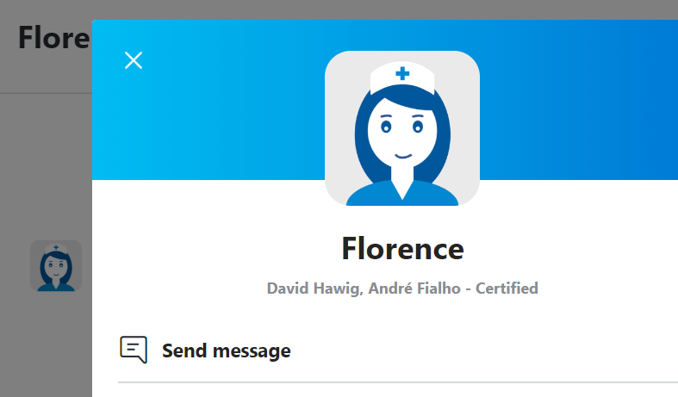
Let’s chat a bit with Florence
Florence is a healthcare chatbot developed by Dutch company Pact that acts as a medication reminder, health tracker, doctor and pharmacy finder etc
We’ll chat with Florence on its (her?) Skype channel:
Notes:
Ask questions about weight loss and nutrition

Slide 21
Social bots
The main aim of social bots is conversational, or in some cases, offering counselling and encouragement
They are often trained from real conversations and do not have access to a KB as such → not suited for general QA
Heavily based on deep learning, often as extensions of machine translation architectures

Slide 22
Open challenges
The main challenge of a fully data-driven approach is that the bot cannot answer “Jane Doe” to question “What’s your name?” just because it has seen it in the data (and “where do you live?”, “how old are you?”…) → need for contextual replies
Response blandness: many “I don’t know”, “Ok” because they have been seen frequently in the data
Inconsistency: contradicting previous statements
Word repetition: typical artefact of deep learning approaches

Slide 23
Blending social bots and QA
Grounded conversation model (Ghazvininejad et al. 2018, USC and Microsoft):
courtesy of the reference and Gao et al. 2019

Slide 24
Recent resources
DSTC challenge series (DSTC9 in 2021): mostly Twitter and Reddit data
Persona-Chat dataset from ConvAI2: crowdsourced participant pairs with assigned personae
Alexa Prize: target: “socialbots that can converse coherently and engagingly for 20 minutes with humans on a range of current events and popular topics such as entertainment, sports, politics, technology, and fashion”. Third edition in 2019. Significant prizes for the best teams

Slide 25

Replika
Replika is a social bot aimed to help with mental wellness. It promises to evolve over time, developing a personality and memory
https://replika.ai/

Slide 26
Note added on 30/08/2021
I have not used Replika personally other than verifying how it works over 2 or 3 sessions. It showed evidence of memory across sessions and noticeable evolution of the conversation
Some of the users who say to have used it extensively have posted comments reporting feeling disrespected at times, crossing of boundaries from the bot, and requests for personal information; the word "creepy" recurs
On LinkedIn, the manufacturer maintains that Replika is "an AI companion who cares", but, in the absence of clearer regulations, it seems that caution must be exercised at all times by the users

Slide 27
Conclusions and takeaways
My personal conclusions on the current state of the three styles of conversational AI that we have reviewed:
Public question answering systems (Google Search, Bing etc) are quite mature and capable of impressive performance. However, the questions have to be self-contained and somehow well-formed

Slide 28
Conclusions and takeaways
Task-oriented chatbots can be quite effective, but it would likely require more than just recycling a few FAQs. Working side by side with experts can help ensure customer satisfaction
Social bots seem to still have some way to go to sustain thorough conversations and are likely at the boundary of “true” artificial intelligence

Slide 29
Main references
Jianfeng Gao, Michel Galley, Lihong Li, Neural Approaches to Conversational AI, Foundations and Trends in Information Retrieval 13(2-3): 127-298 (2019)
Tri Nguyen, Mir Rosenberg, Xia Song, Jianfeng Gao, Saurabh Tiwary, Rangan Majumder, Li Deng, MS MARCO: A Human Generated MAchine Reading COmprehension Dataset, arXiv, v3, 31 Oct 2018
2019 Chatbot Platform Comparison Reviews, Ometrics, April 2019, https://www.ometrics.com/blog/chatbot-platform-comparison-reviews/
Engati E-Brochure, https://www.engati.com/assets/Engati-multipager.pdf, April 2019
Einstein Bots Basics module, Salesforce Trailhead, April 2019, https://trailhead.salesforce.com/content/learn/modules/service_bots_basics
Theo van Kraay, Build a bot in under 3 minutes… in Azure!, TechNet UK Blog, 18 Nov 2018
Florence – your health assistant, https://www.florence.chat/, April 2019
Replika – The AI companion who cares, https://www.replika.ai/, April 2019

